Slide 1

Share My Car
Group: 130
Yuhui Liu XinXin Ai
Binh Dang Yuanxi Zeng

Slide 2
Introduction
ShareMyCar is an app which provides sharing cars service
Car owners provide their cars at available time to our customer services and we post on our app
Customers can directly rent the car on our app

Slide 3
Problem Solved
Target customers
Demands for renting cars within a short time for traveling
Demands for renting cars with cheap price
Demands for renting cars with simple process
Fully used the available time of cars in an efficient way
Travelers
Private car owners

Slide 4
Compare with existing solutions
The existing solutions are normally car renting agency or companies or Uber
They bought their own cars and insurance
They do not have this customer-to-customer services
Complex process and more expensive price
We do not need to buy cars so saving more cost
Provides better car resources( private cars get protected better)
Cheaper price and simple process
New business model

Slide 5
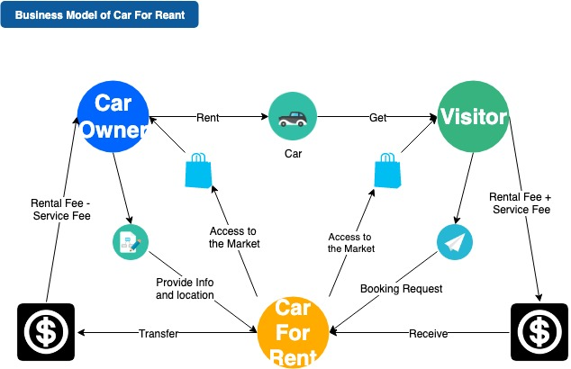
Business Model

Slide 6
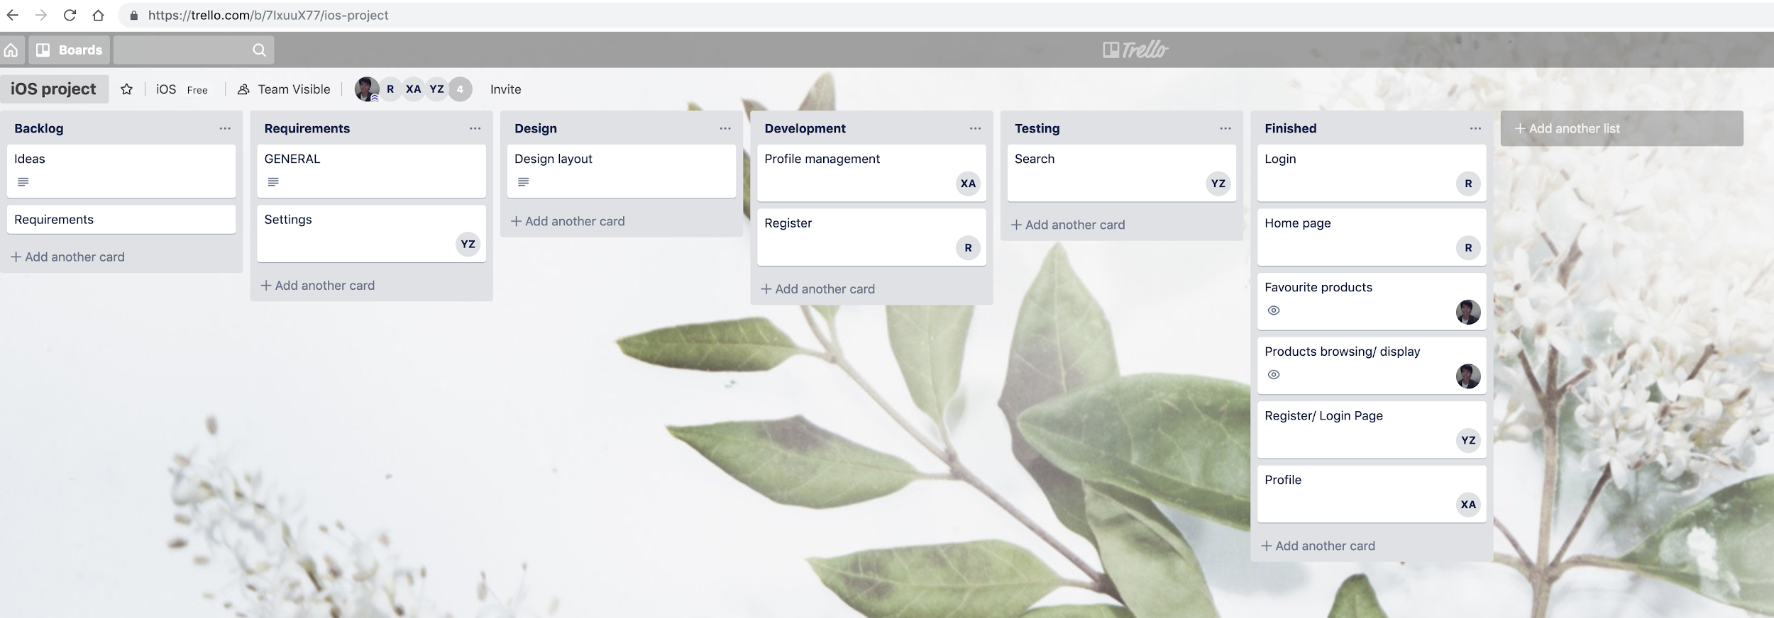
Project process

Slide 7
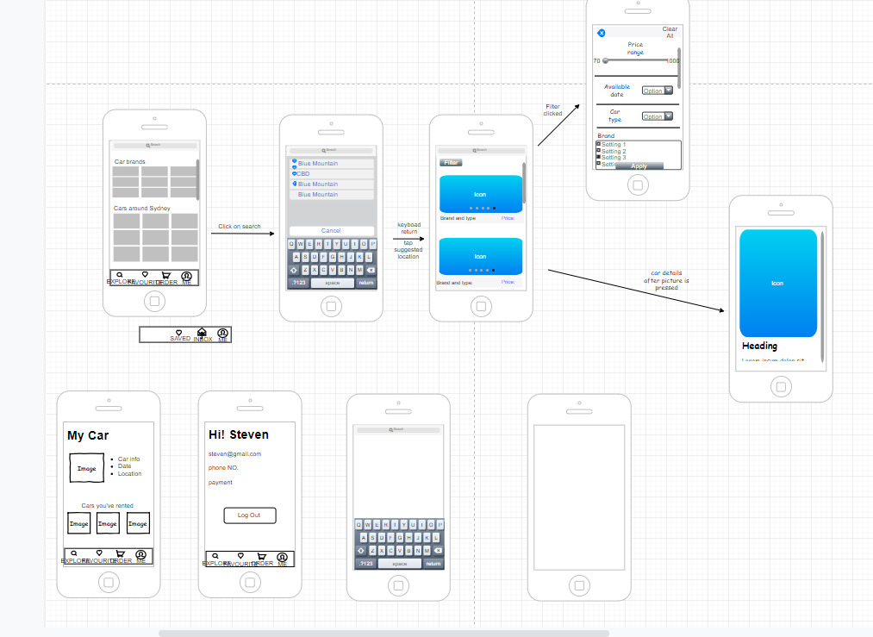
UI design phase by Drawio

Slide 8
Implement phase

Slide 9
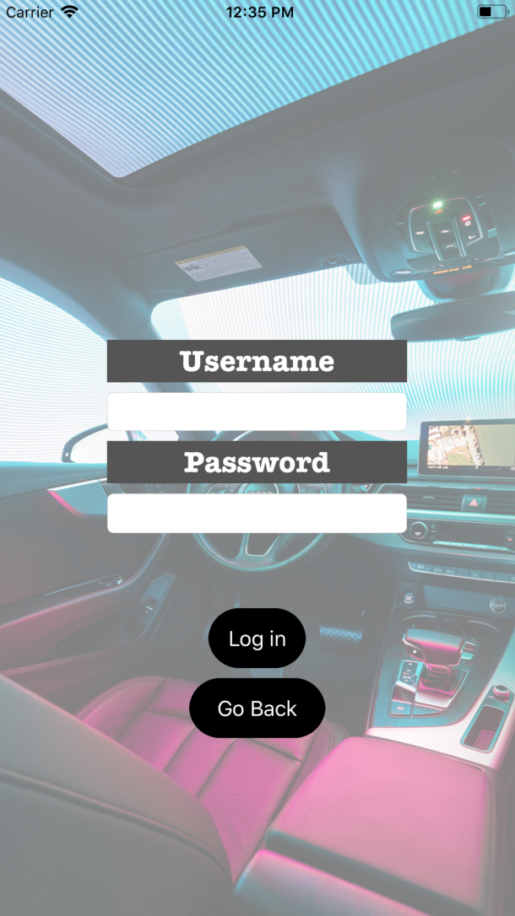
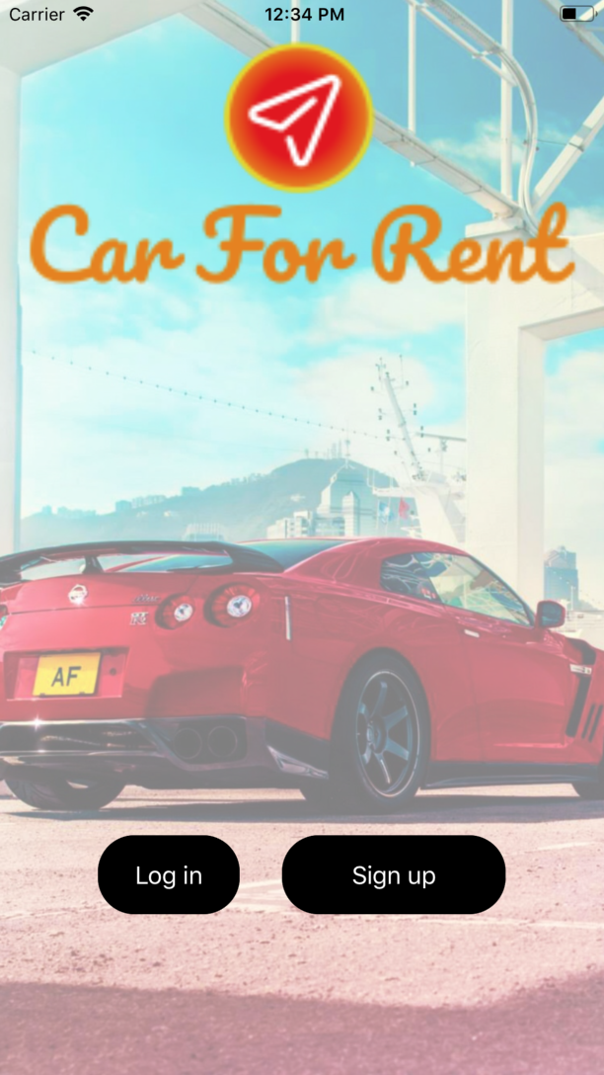
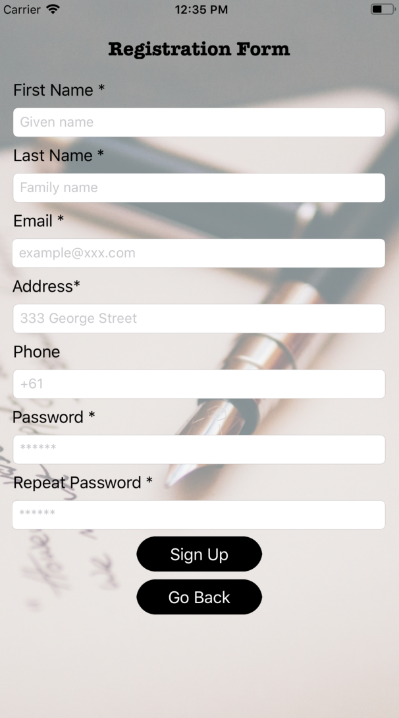
Login & Registration Page

Slide 10
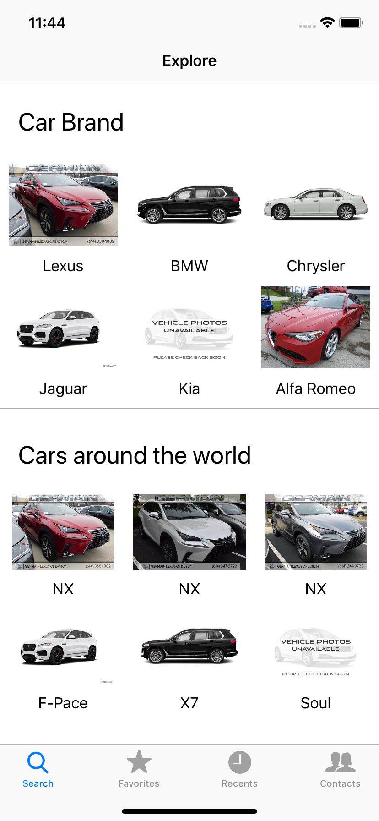
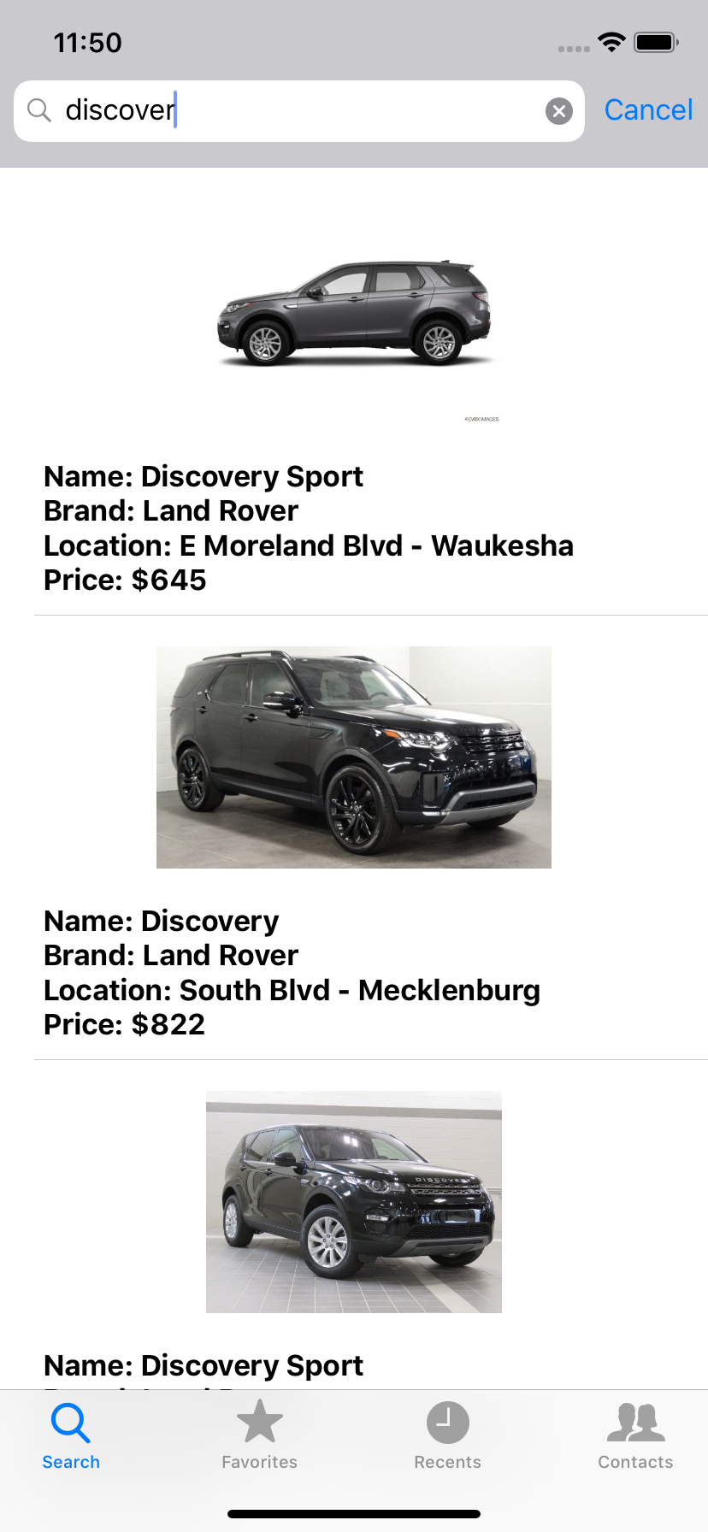
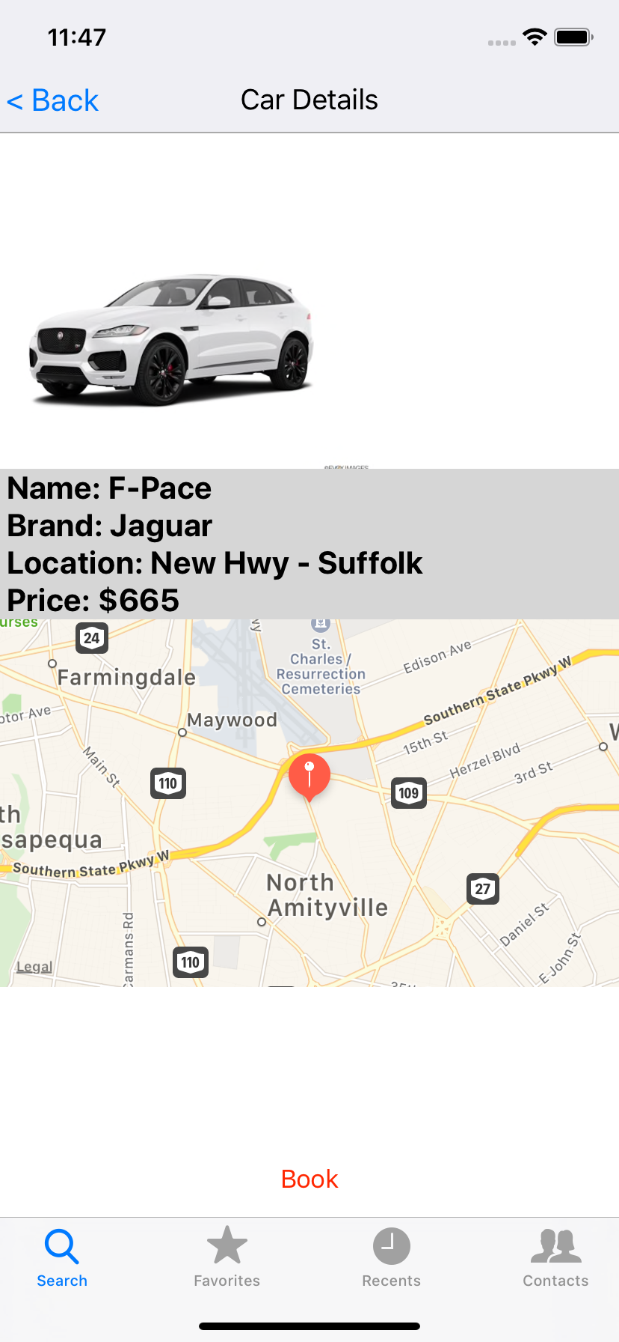
Explore And Search
Show a list of cars
Show one car

Slide 11
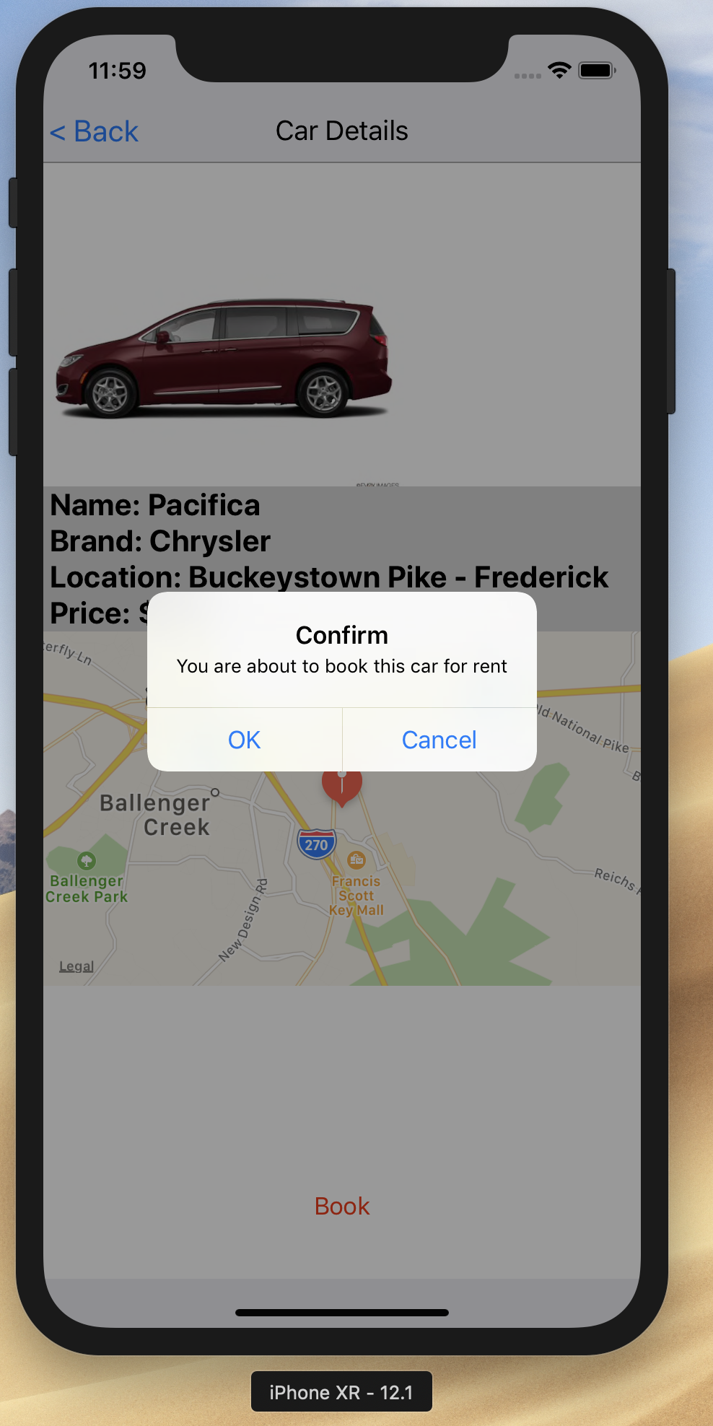
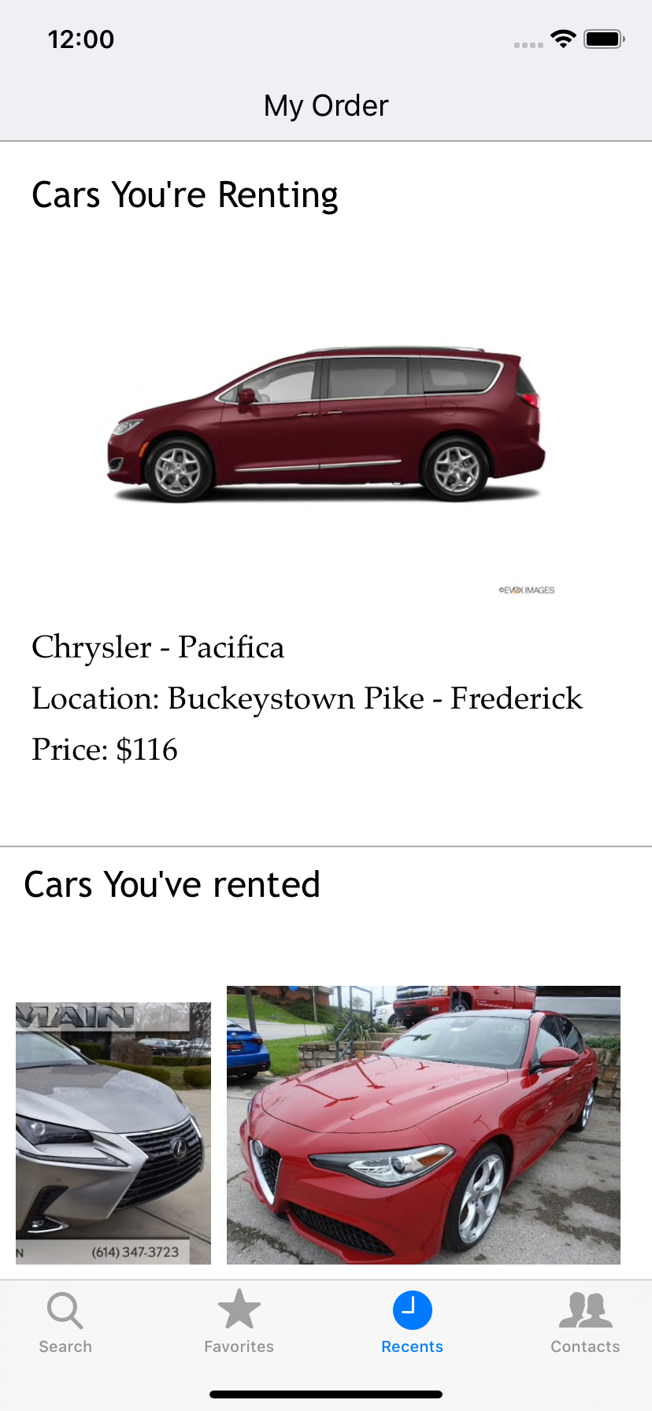
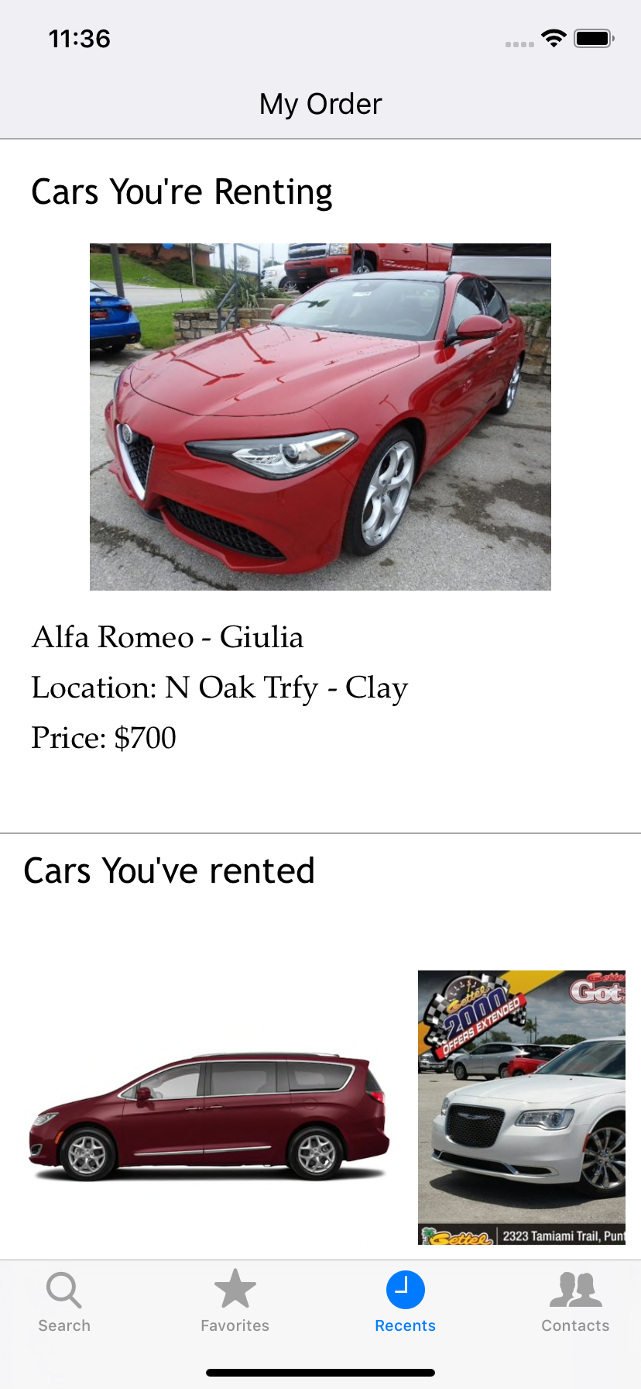
Book A CAR
Current Order view
Last Order View

Slide 12


Frameworks

Slide 13
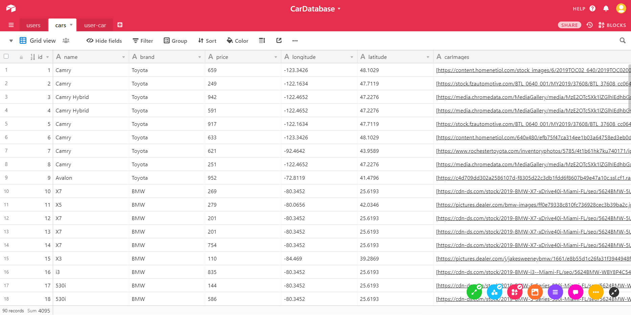
Database

Slide 14
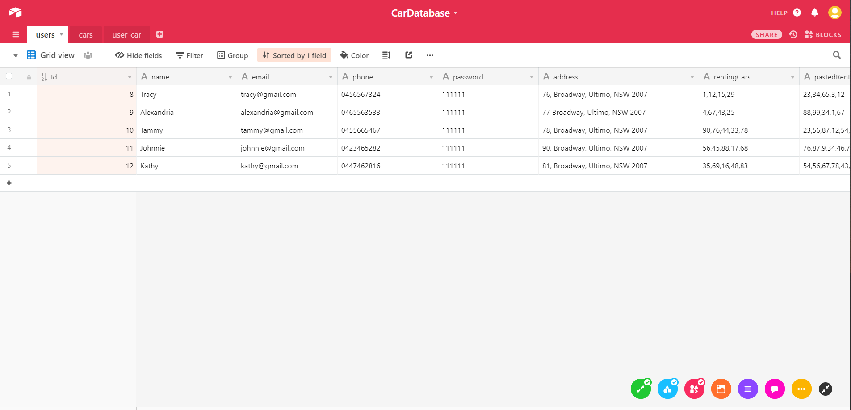

Slide 15
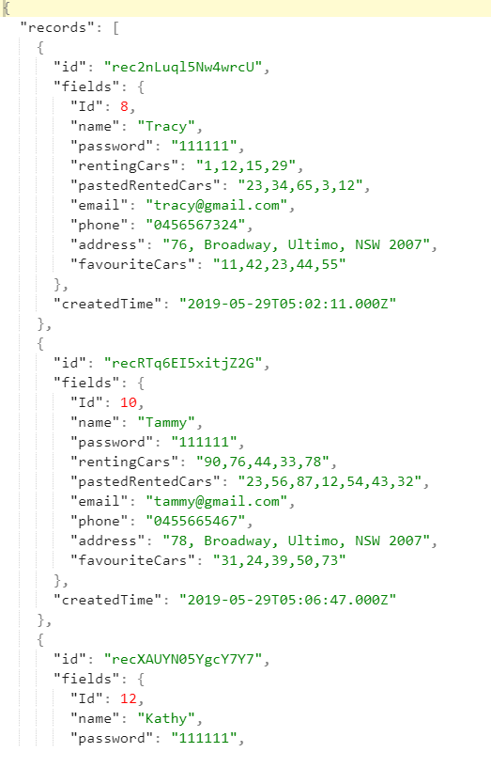
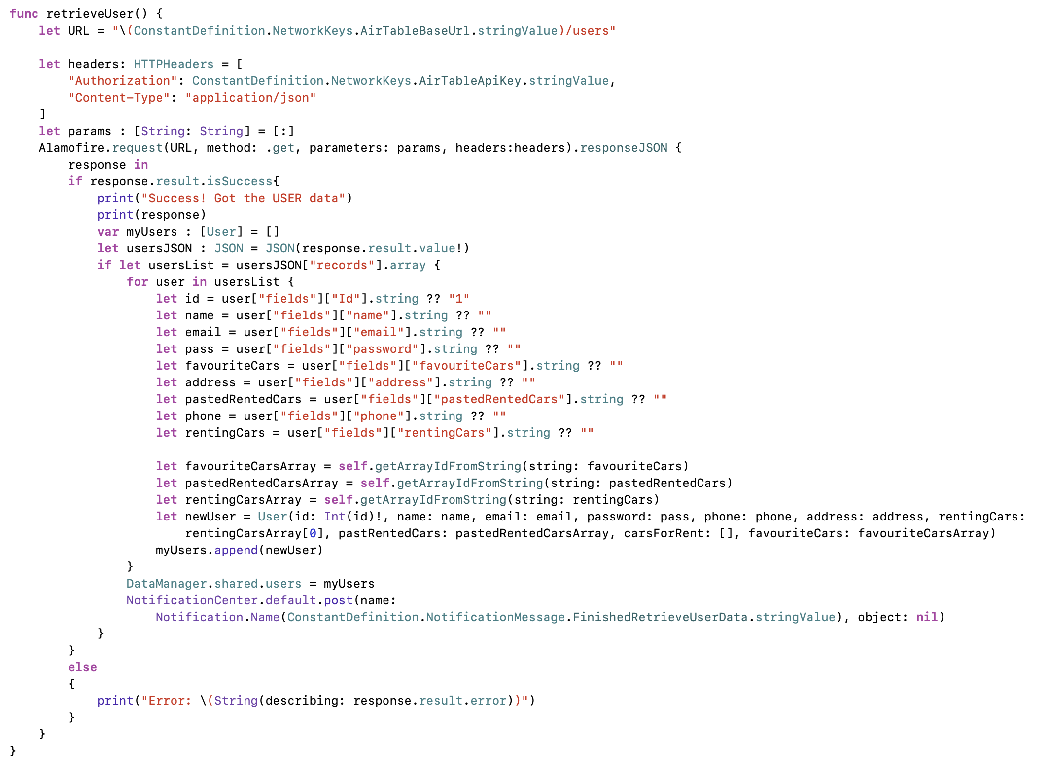
Alamofire and SwiftyJSON

Slide 16
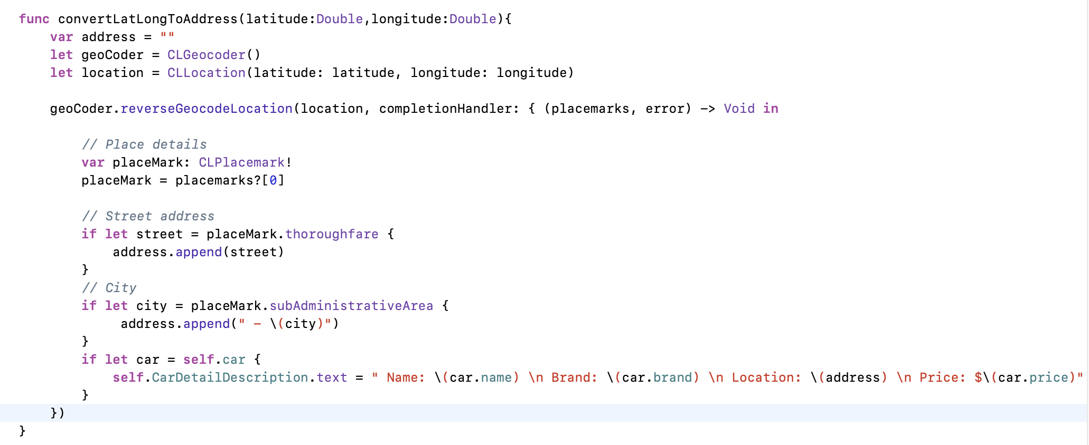
Mapkit

Slide 17
Thank you!
and
QUESTION TIME

